Slide 1
Chapter 7
How to work with Razor views

Slide 2
Objectives (part 1)
Applied
Develop strongly-typed Razor views that display the elements that are unique for a web page.
Develop Razor layouts that provide the elements that are the same for multiple pages.
Knowledge
Distinguish between a Razor code block and inline expressions, loops, and if statements.
Distinguish between an inline conditional statement and an inline conditional expression.
Describe how an MVC web app typically maps its views to the action methods of its controllers.
Describe the use of tag helpers to generate a URL.

Slide 3
Objectives (part 2)
Distinguish between a relative URL and an absolute URL.
Describe how to pass a model to a view.
Distinguish between the @model directive and the @Model property.
Describe how to bind an HTML element to a property of a view’s model.
Describe how to bind a <select> element to a list of items.
Describe how to display a list of items in a <table> element.
Describe how to create and apply a layout.
Describe how to build layouts by nesting one layout within another.

Slide 4
Objectives (part 3)
Describe how a layout can use the ViewContext property to get data about the route of the current view.
Describe how to code a section in a view and render that section in a layout.

Slide 5
The syntax for a Razor code block
@{
// one or more C# statements
}
The syntax for an inline expression
@(csharp_expression)

Slide 6
The Index() action method of the Home controller
public IActionResult Index()
{
ViewBag.CustomerName = "John";
return View(); // returns Views/Home/Index.cshtml
}

Slide 7
The Views/Home/Index.cshtml file
@{
string message = "Welcome!";
if (ViewBag.CustomerName != null)
{
message = "Welcome back!";
}
}
<!DOCTYPE html>
<html>
<head>
<meta name="viewport" content="width=device-width" />
<title>Home</title>
</head>
<body>
<h1>@message</h1>
<p>Customer Name: @ViewBag.CustomerName</p>
<p>2 + 2 = @(2 + 2)</p>
</body>
</html>

Slide 8
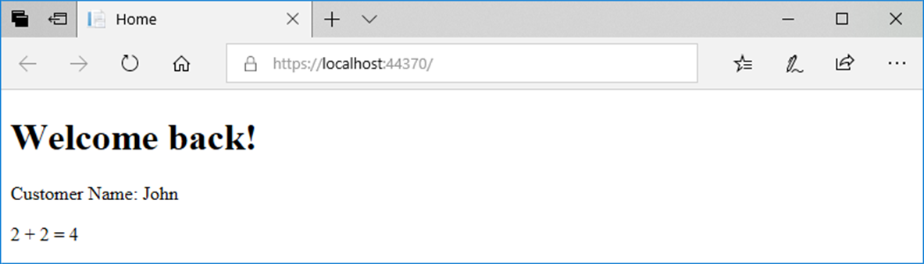
The view displayed in a browser

Slide 9
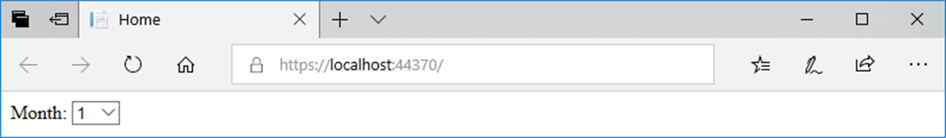
A for loop that displays a drop-down list of month numbers
<label for="month">Month:</label>
<select name="month" id="month">
@for (int month = 1; month <= 12; month++)
{
<option value="@month">@month</option>
}
</select>
The result displayed in a browser

Slide 10
Code in a controller that creates a list of strings
public IActionResult Index()
{
ViewBag.Categories = new List<string>
{
"Guitars", "Basses", "Drums"
};
return View();
}

Slide 11
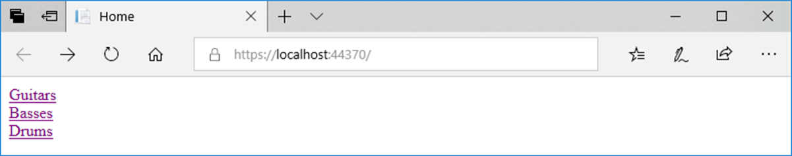
A foreach loop that displays a list of links
@foreach (string category in ViewBag.Categories)
{
<div>
<a href="/Product/List/@category/">@category</a>
</div>
}
The result displayed in a browser

Slide 12
An if-else statement in a view
@if (ViewBag.ProductID == 1)
{
<p>Fender Stratocaster</p>
}
else if (ViewBag.ProductID == 2)
{
<p>Gibson Les Paul</p>
}
else
{
<p>Product Not Found</p>
}

Slide 13
A switch statement in a view
@switch (ViewBag.ProductID)
{
case 1:
<p>Fender Stratocaster</p>
break;
case 2:
<p>Gibson Les Paul</p>
break;
default:
<p>Product Not Found</p>
break;
}

Slide 14
An if statement that adds a Bootstrap CSS class if true
<a asp-controller="Product" asp-action="List"
asp-route-id="All"
class="list-group-item
@if (ViewBag.SelectedCategoryName == "All") {
<text>active</text>
}">
All
</a>

Slide 15
A conditional expression that adds a Bootstrap CSS class if true
<a asp-controller="Product" asp-action="List" asp-route-id="All"
class="list-group-item
@(ViewBag.SelectedCategoryName == "All" ? "active" : "")">
All
</a>

Slide 16
The starting folders and files for the Guitar Shop app
GuitarShop
/Controllers
/HomeController.cs
/ProductController.cs
/Models
/Category.cs
/Product.cs
/Views
/Home
/Index.cshthml -- the view for the Home/Index action
/About.cshthml -- the view for the Home/About action
/Product
/List.cshthml -- the view for the Product/List action
/Details.cshthml -- the view for the Product/Details action
/Update.cshthml -- the view for the Product/Update action
/Shared
/_Layout.cshtml -- a layout that can be shared by views
_ViewImports.cshtml -- imports models and tag helpers for views
_ViewStart.cshtml -- specifies the default layout for views
/wwwroot
/css
/custom.css
/lib
/bootstrap/css/bootstrap.min.css
Startup.cs -- configures middleware that may impact views
Program.cs -- sets up the app

Slide 17
The routing that’s specified in the Startup.cs file
app.UseRouting();
app.UseEndpoints(endpoints =>
{
endpoints.MapControllerRoute(
name: "default",
pattern: "{controller=Home}/{action=Index}/{id?}");
});

Slide 18
A method that a controller can use to return a view result to the browser
View()
View(name)

Slide 19
The Home controller
public class HomeController : Controller
{
public IActionResult Index()
{
return View(); // Views/Home/Index.cshtml
}
}

Slide 20
The Product controller
public class ProductController : Controller
{
public IActionResult Index()
{
return View("List"); // Views/Product/List.cshtml
}
public IActionResult List(string id = "All")
{
ViewBag.Category = id;
return View(); // Views/Product/List.cshtml
}
public IActionResult Details(string id)
{
ViewBag.ProductSlug = id;
return View(); // Views/Product/Details.cshtml
}
}

Slide 21
The _Layout.cshtml file in the Views/Shared folder
<!DOCTYPE html>
<html>
<head>
<title>@ViewBag.Title</title>
<link rel="stylesheet"
href="~/lib/bootstrap/css/bootstrap.min.css" />
<link rel="stylesheet" href="~/css/custom.css" />
</head>
<body>
@RenderBody()
</body>
</html>

Slide 22
A _ViewStart.cshtml file that sets the default layout
@{
Layout = "_Layout";
}
A _ViewImports.cshtml file that enables all ASP.NET Core MVC tag helpers
@addTagHelper *, Microsoft.AspNetCore.Mvc.TagHelpers

Slide 23
How to add a Razor layout, view start, or view imports file
Right-click on the folder where you want to add the file, and select the Add→New Item item.
In the resulting dialog, select the ASP.NET Core→Web category.
Select the Razor item you want to add and respond to the resulting dialog boxes.

Slide 24
Three tag helpers for generating URLs
asp-controller
asp-action
asp-route-param_name

Slide 25
Two ways to code a link
Use HTML to hard code the URL in the href attribute
<a href="/Product/List/Guitars">View guitars</a>
Use ASP.NET tag helpers to generate the URL
<a asp-controller="Product" asp-action="List"
asp-route-id="Guitars">View guitars</a>
The URL for both links
/Product/List/Guitars

Slide 26
How to code a link to an action method in the same controller
<a asp-action="About">About Us</a>
The URL that’s generated
/Home/About
How to code a link to an action method in a different controller
<a asp-controller="Product" asp-action="List">
View all products</a>
The URL that’s generated
/Product/List

Slide 27
How to code a link that includes a parameter that’s in a route
<a asp-controller="Product" asp-action="List"
asp-route-id="Guitars">View guitars</a>
The URL that’s generated
/Product/List/Guitars
A link that specifies a route parameter that doesn’t exist
<a asp-controller="Product" asp-action="List"
asp-route-page="1" asp-route-sort_by="price">
Products - Page 1</a>
The URL that’s generated
/Product/List?page=1&sort_by=price

Slide 28
The Home/Index view
@{
ViewBag.Title = "Home";
}
<h1>Home</h1>
<div class="list-group">
<a asp-controller="Product" asp-action="List">
View all products</a>
<a asp-controller="Product" asp-action="List"
asp-route-id="Guitars">View guitars</a>
<a asp-controller="Product" asp-action="Details"
asp-route-id="Fender-Stratocaster">
View Fender Stratocaster</a>
</div>

Slide 29
The Product/List view
@{
ViewBag.Title = "Product List";
}
<h1>Product List</h1>
<div class="list-group">
<p>Category: @ViewBag.Category</p>
<a asp-action="Details"
asp-route-id="Fender-Stratocaster">
View Fender Stratocaster</a>
<a asp-controller="Home" asp-action="Index">Home</a>
</div>

Slide 30
The Product/Details view
@{
ViewBag.Title = "Product Details";
}
<h1>Product Details</h1>
<div class="list-group">
<p>Slug: @ViewBag.ProductSlug</p>
<a asp-controller="Home" asp-action="Index">Home</a>
</div>

Slide 31
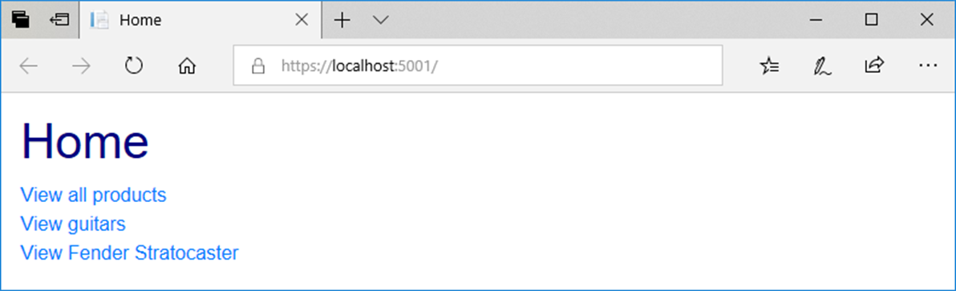
A browser displaying the Home page

Slide 32
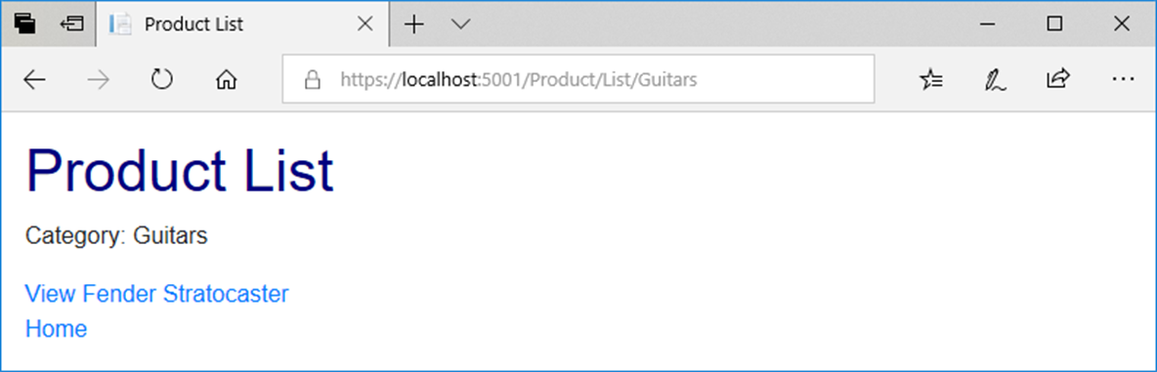
A browser after clicking the View Guitars link

Slide 33
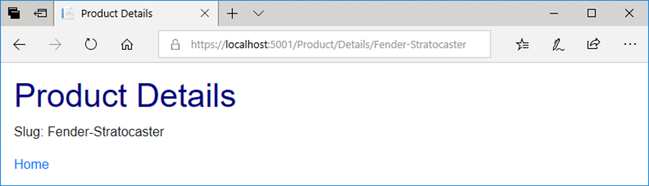
A browser after requesting the View Fender Stratocaster link

Slide 34
More tag helpers for generating URLs
asp-area
asp-fragment
asp-protocol
asp-host

Slide 35
How to code a link to an area
<a asp-area="Admin" asp-controller="Product"
asp-action="List">Admin - Product Manager</a>
The URL that’s generated
/Admin/Product/List

Slide 36
How to code an HTML placeholder
<h2 id="Fender">Fender Guitars</h2>
How to code a URL that jumps to an HTML placeholder on the same page
<a asp-fragment="Fender">View Fender Guitars</a>
The URL that’s generated
/#Fender

Slide 37
How to code an absolute URL
<a asp-protocol="https"
asp-host="murach.com"
asp-controller="Shop"
asp-action="Details"
asp-route-id="html5-and-css3"
asp-fragment="reviews">Murach's HTML5 and CSS3 - Reviews</a>
The URL that’s generated
https://www.murach.com/Shop/Details/html5-and-css3#reviews

Slide 38
Format specifiers you can use to format numbers
Specifier Name
C Currency
N Number
P Percent

Slide 39
Code that stores numbers in the ViewBag
ViewBag.Price = 12345.67;
ViewBag.DiscountPercent = .045;
ViewBag.Quantity = 1234;

Slide 40
Razor expressions that format the numbers
Expression Result
@ViewBag.Price.ToString("C") $12,345.67
@ViewBag.Price.ToString("C1") $12,345.7
@ViewBag.Price.ToString("C0") $12,346
@ViewBag.Price.ToString("N") 12,345.67
@ViewBag.Price.ToString("N1") 12,345.7
@ViewBag.Price.ToString("N0") 12,346
@ViewBag.DiscountPercent.ToString("P") 4.50%
@ViewBag.DiscountPercent.ToString("P1") 4.5%
@ViewBag.DiscountPercent.ToString("P0") 5%

Slide 41
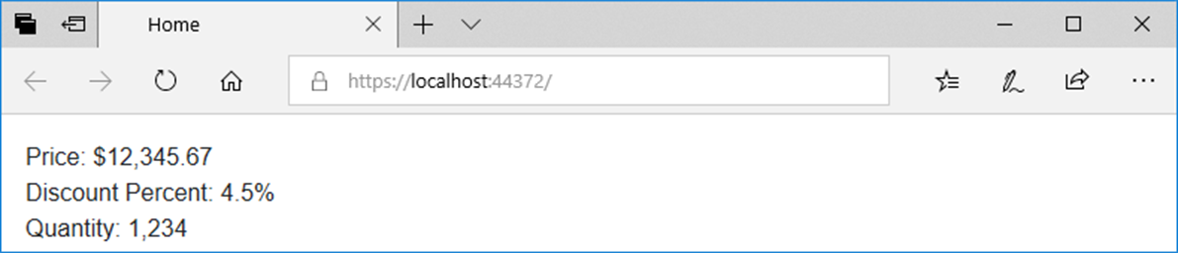
Code in a view that displays the numbers
<div>Price: @ViewBag.Price.ToString("C")</div>
<div>Discount Percent: @ViewBag.DiscountPercent.ToString("P1")</div>
<div>Quantity: @ViewBag.Quantity.ToString("N0")</div>
The view displayed in a browser

Slide 42
The Product model
namespace GuitarShop.Models
{
public class Product
{
public int ProductID { get; set; }
public Category Category { get; set; }
public string Name { get; set; }
public decimal Price { get; set; }
public string Slug => Name.Replace(' ', '-');
}
}

Slide 43
The Category model
namespace GuitarShop.Models
{
public class Category
{
public int CategoryID { get; set; }
public string Name { get; set; }
}
}

Slide 44
A method that a controller can use to pass a model to a view
View(model)
View(name, model)
The Product/Details() action method that passes a model to a view
public IActionResult Details(int id) {
Product product = context.Products.Find(id);
return View(product);
}
A Product/Add() action method that passes a model to the specified view
[HttpGet]
public IActionResult Add() {
return View("Update", new Product());
}

Slide 45
A directive for displaying model properties in a view
@model
A property for displaying model properties in a view
@Model

Slide 46
A _ViewImports file that imports the Models namespace for all views
@addTagHelper *, Microsoft.AspNetCore.Mvc.TagHelpers
@using GuitarShop.Models
The code for the Product/Details view
@model Product
@{
ViewBag.Title = "Product Details";
}
<h1>Product Details</h1>
<div>ID: @Model.ProductID</div>
<div>Name: @Model.Name</div>
<div>Category: @Model.Category.Name</div>
<div>Price: @Model.Price.ToString("C2")</div>
<a asp-controller="Home" asp-action="Index">Home</a>

Slide 47
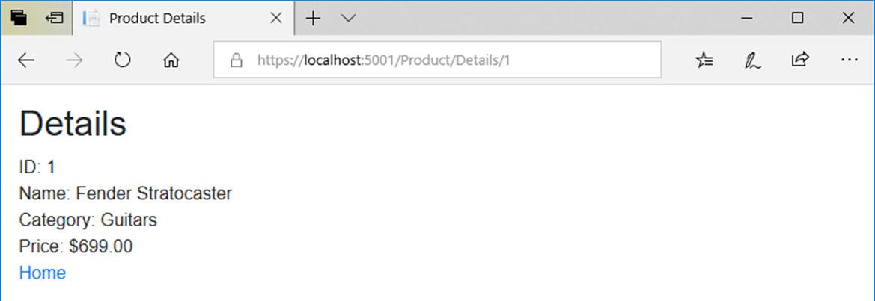
The view with model properties in a browser

Slide 48
A tag helper for binding HTML elements to model properties
asp-for
A view with asp-for tag helpers (part 1)
@model Product
@{
ViewBag.Title = "Update Product";
}
<h1>Update Product</h1>
<form asp-action="Update" method="post">
<div class="form-group">
<label asp-for="Name"></label>
<input asp-for="Name" class="form-control">
</div>
<div class="form-group">
<label asp-for="Price"></label>
<input asp-for="Price" class="form-control">
</div>

Slide 49
A view with asp-for tag helpers (part 2)
<input type="hidden" asp-for="ProductID" />
<input type="hidden" asp-for="Category.Name" />
<button asp-action="Update" type="submit"
class="btn btn-primary">Update
</button>
<a asp-action="List" class="btn btn-primary">
Cancel</a>
</form>

Slide 50
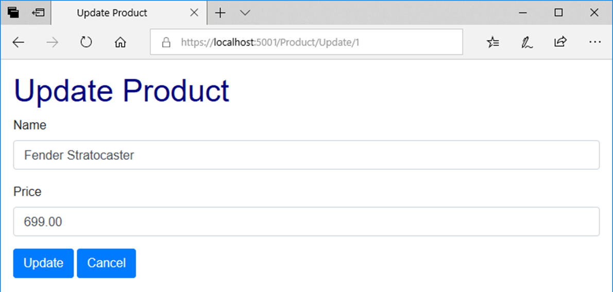
The view with bound properties in a browser

Slide 51
The HTML that’s generated for the Price <label> and <input> elements
<label for="Price">Price</label>
<input class="form-control" type="text"
id="Price" name="Price" value="699.00">

Slide 52
A tag helper for adding options to a <select> element
asp-items
The constructor of the SelectList class
SelectList(list, value, text, selectedValue)

Slide 53
An Update action method that creates the model and passes it to the view
public IActionResult Update(int id)
{
ViewBag.Categories = context.Categories.ToList();
Product product = context.Products.Find(id);
return View(product);
}

Slide 54
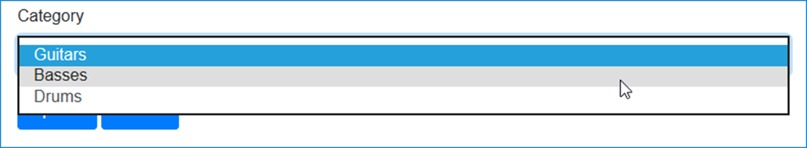
The code that binds items to a <select> element
<div class="form-group">
<label asp-for="CategoryID">Category</label>
<select asp-for="CategoryID"
asp-items="@(new SelectList(ViewBag.Categories,
"CategoryID", "Name",
Model.CategoryID.ToString()))"
class="form-control"></select>
</div>
The <select> element and its label displayed in a browser

Slide 55
HTML that’s generated for the <select> element
<select class="form-control" id="Category_CategoryID"
name="Category.CategoryID">
<option selected="selected" value="1">
Guitars</option>
<option value="2">Basses</option>
<option value="3">Drums</option>
</select>

Slide 56
A List action method that creates the model and passes it to the view
public IActionResult List(string id = "All")
{
ViewBag.Categories = context.Categories.ToList();
ViewBag.SelectedCategory = id;
List<Product> products = context.Products
.Where(p => p.Category.Name == id).ToList();
return View(products);
}

Slide 57
The code for the view (part 1)
@model List<Product>
@{
ViewBag.Title = "Product List";
}
<h1>Product List</h1>
@if (ViewBag.Categories != null)
{
foreach (Category c in ViewBag.Categories)
{
<a asp-controller="Product" asp-action="List"
asp-route-id="@c.Name">@c.Name</a>
<text> | </text>
}
}
<a asp-controller="Product" asp-action="List"
asp-route-id="All">All</a>
<hr />

Slide 58
The code for the view (part 2)
@if (@ViewBag.SelectedCategory == "All")
{
<h2>All Products</h2>
}
else
{
<h2>@ViewBag.SelectedCategory</h2>
}
<table class="table table-bordered table-striped">
<thead>
<tr>
<th>Name</th>
<th>Price</th>
<th></th>
<th></th>
</tr>
</thead>

Slide 59
The code for the view (part 3)
<tbody>
@foreach (var product in @Model)
{
<tr>
<td>@product.Name</td>
<td>@product.Price.ToString("C")</td>
<td>
<a asp-controller="Product"
asp-action="Details"
asp-route-id="@product.ProductID">
View</a>
</td>
<td>
<a asp-controller="Product"
asp-action="Update"
asp-route-id="@product.ProductID">
Update</a>
</td>
</tr>
}
</tbody>
</table>

Slide 60
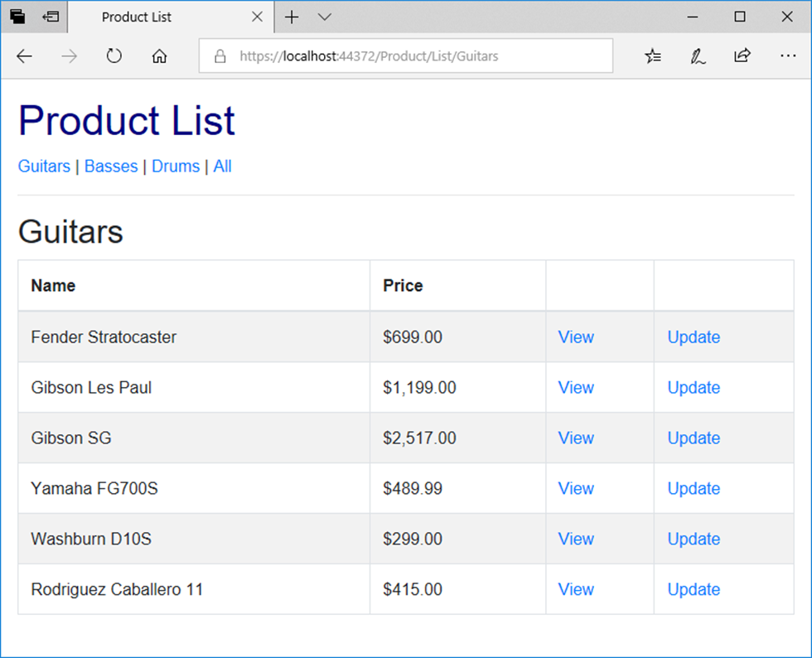
The Product objects view in a browser

Slide 61
The Views/Shared/_MainLayout.cshtml file (part 1)
<!DOCTYPE html>
<html>
<head>
<title>@ViewBag.Title</title>
<link rel="stylesheet" href="~/lib/bootstrap/css/bootstrap.min.css" />
<link rel="stylesheet" href="~/css/custom.css" />
</head>
<body>
<header>
<a asp-controller="Home" asp-action="Index">
Home</a> |
<a asp-controller="Product" asp-action="List">
Products</a> |
<a asp-controller="Home" asp-action="About">
About</a>
<hr />
</header>

Slide 62
The Views/Shared/_MainLayout.cshtml file (part 2)
@RenderBody()
<footer>
<hr />
<p>&copy; @DateTime.Now.Year - Guitar Shop</p>
</footer>
</body>
</html>

Slide 63
The code for a _ViewStart.cshtml file that sets the default layout
@{
Layout = "_Layout";
}
The code for a Home/Index view that explicitly specifies a layout
@{
Layout = "_MainLayout";
ViewBag.Title = "Home";
}
<p>Welcome to the Guitar Shop website!</p>

Slide 64
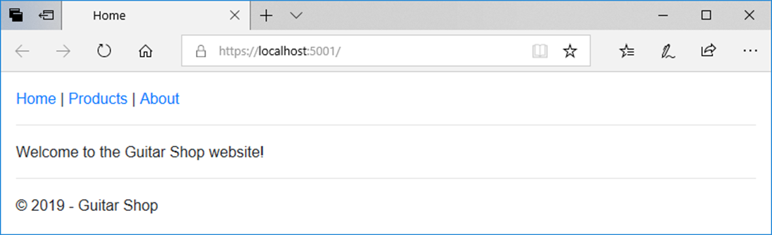
The Home page

Slide 65
The _Layout file
<!DOCTYPE html>
<html>
<head>
<title>@ViewBag.Title</title>
<link rel="stylesheet"
href="~/lib/bootstrap/css/bootstrap.min.css" />
<link rel="stylesheet" href="~/css/custom.css" />
</head>
<body>
@RenderBody()
</body>
</html>

Slide 66
The _MainLayout file
@{
Layout = "_Layout";
}
<header>
<a asp-controller="Home" asp-action="Index">Home</a> |
<a asp-controller="Product" asp-action="List"
asp-route-id="All">Products</a> |
<a asp-controller="Home" asp-action="About">About</a>
<hr />
</header>
@RenderBody()
<footer>
<hr />
<p>&copy; @DateTime.Now.Year - Guitar Shop</p>
</footer>

Slide 67
The _ProductLayout file
@{
Layout = "_MainLayout";
}
<h1>Product Manager</h1>
@if (ViewBag.Categories != null)
{
foreach (Category c in ViewBag.Categories)
{
<a asp-controller="Product" asp-action="List"
asp-route-id="@c.Name">@c.Name</a><text> | </text>
}
<a asp-controller="Product" asp-action="List"
asp-route-id="All">All</a>
}
<hr />
@RenderBody()

Slide 68
The code for a view that uses the _ProductLayout view
@model List<Product>
@{
Layout = "_ProductLayout";
ViewBag.Title = "Product List";
}
@if (@ViewBag.SelectedCategory == "All")
{
<h2>All Products</h2>
}
else
{
<h2>@ViewBag.SelectedCategory</h2>
}
<!-- The code for the <table> element -->

Slide 69
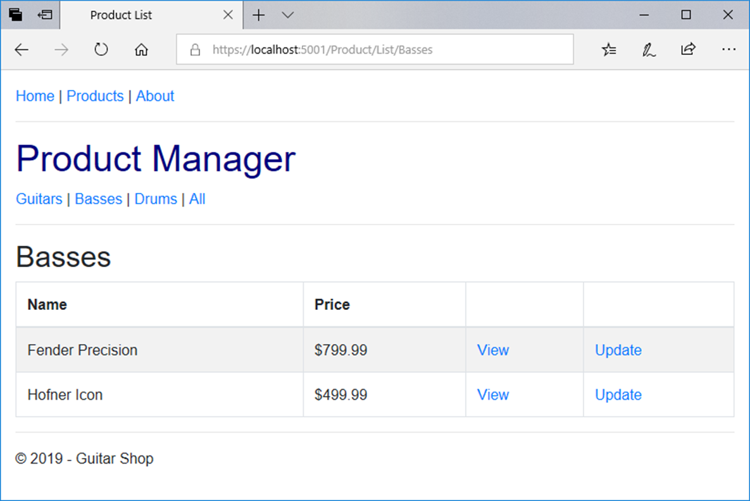
The view with nested layouts in a browser

Slide 70
A _MainLayout file that uses view context (part 1)
@{
Layout = "_Layout";
string controller =
ViewContext.RouteData.Values["controller"].ToString();
string action =
ViewContext.RouteData.Values["action"].ToString();
}
<nav class="navbar navbar-dark bg-primary fixed-top">
<a class="navbar-brand" href="/">My Guitar Shop</a>
<div class="navbar-nav">
<a class="nav-link
@(controller == "Home" && action == "Index" ?
"active" : "")"
asp-controller="Home" asp-action="Index">Home</a>
<a class="nav-link
@(controller == "Product" ? "active" : "")"
asp-controller="Product" asp-action="List">
Products</a>
<a class="nav-link
@(controller == "Home" && action == "About" ?
"active" : "")"
asp-controller="Home" asp-action="About">About</a>
</div>
</nav>

Slide 71
A _MainLayout file that uses view context (part 2)
@RenderBody()
<footer>
<hr />
<p>&copy; @DateTime.Now.Year - Guitar Shop</p>
</footer>

Slide 72
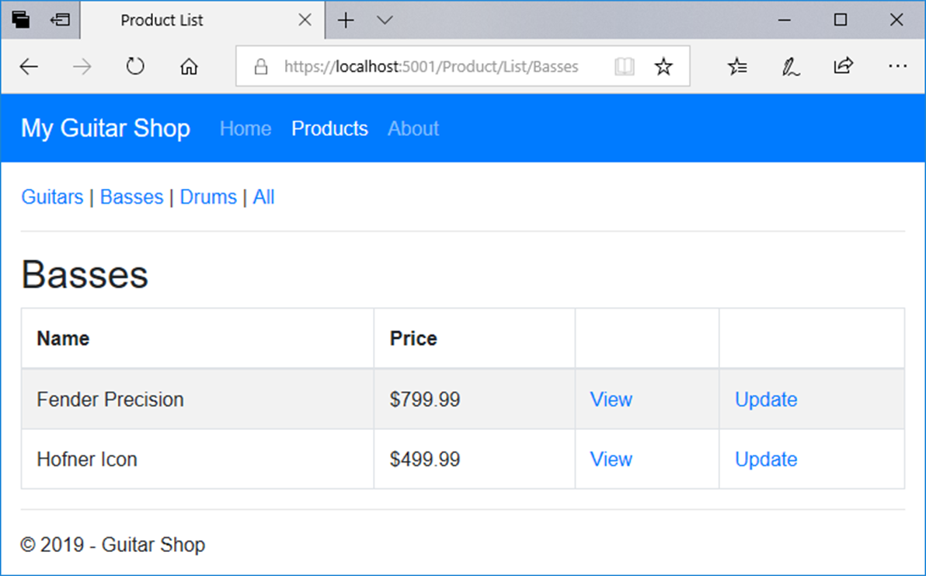
A view that uses this layout

Slide 73
Code in a view file that specifies a section
@model Product
@{
ViewBag.Title = "Update Product";
}
@section scripts {
<script src="~/lib/jquery-validate/jquery.validate.min.js">
</script>
<script src="~/lib/jquery-validation-unobtrusive/
jquery.validate.unobtrusive.min.js">
</script>
}
<h2>Update</h2>
// the HTML elements for the rest of the view body go here

Slide 74
A method that can insert content from a section into a layout
RenderSection(name, isRequired)
A layout file that specifies an optional section
<!DOCTYPE html>
<html>
<head>
<title>@ViewBag.Title</title>
<link rel="stylesheet"
href="~/lib/bootstrap/css/bootstrap.min.css" />
<link rel="stylesheet" href="~/css/custom.css" />
<script src="~/lib/jquery/jquery.min.js"></script>
<script src="~/lib/popper.js/popper.min.js"></script>
<script src="~/lib/bootstrap/js/bootstrap.min.js"></script>
@RenderSection("scripts", false)
</head>
<body>
@RenderBody()
</body>
</html>

Slide 75
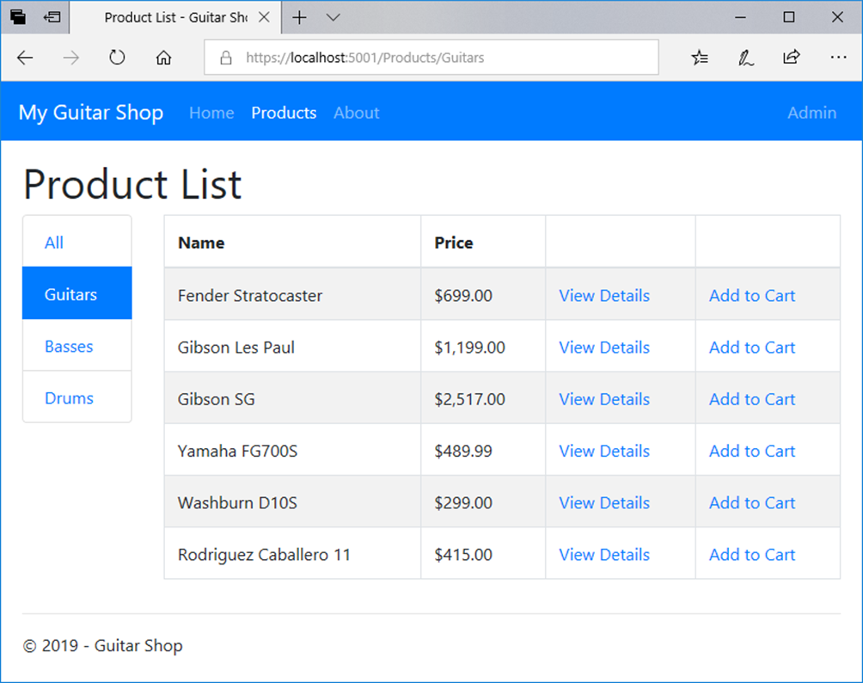
The Product List page for customers

Slide 76
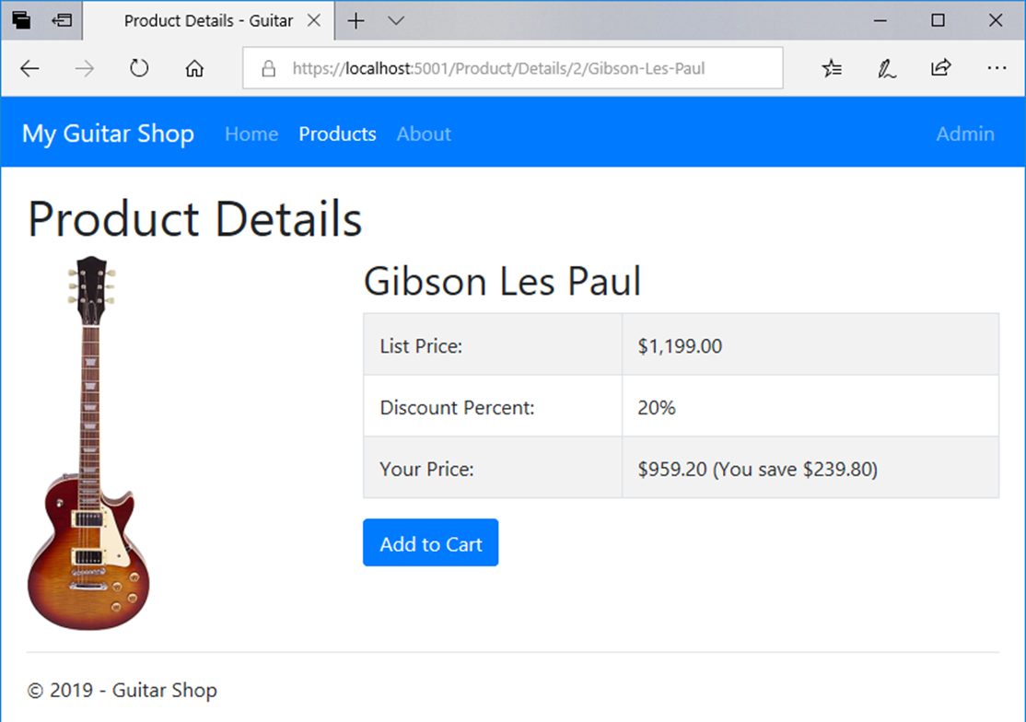
The Product Details page

Slide 77
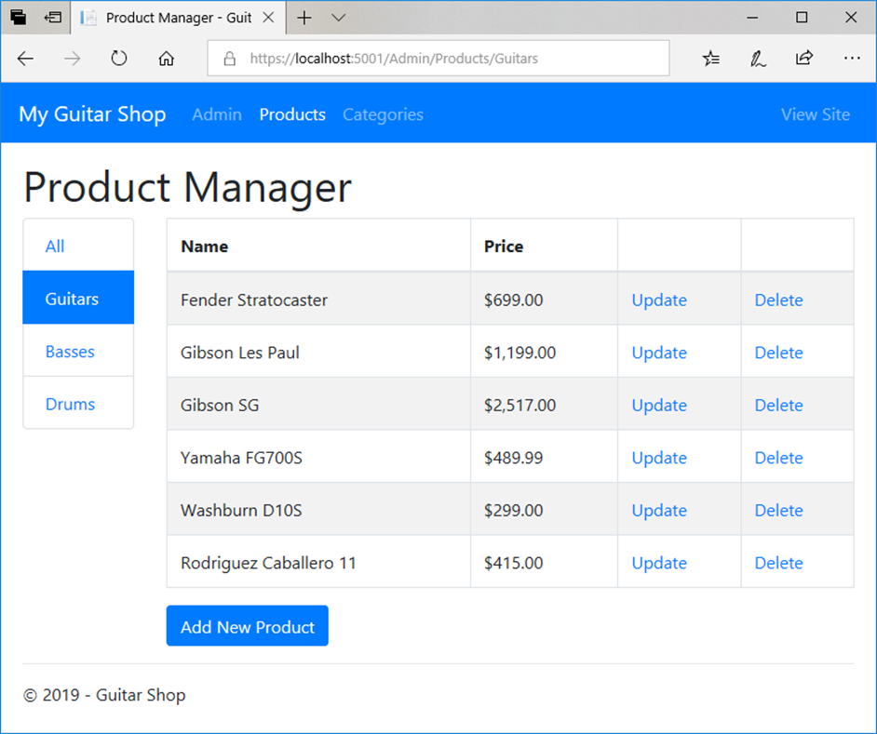
The Product Manager page for administrators

Slide 78
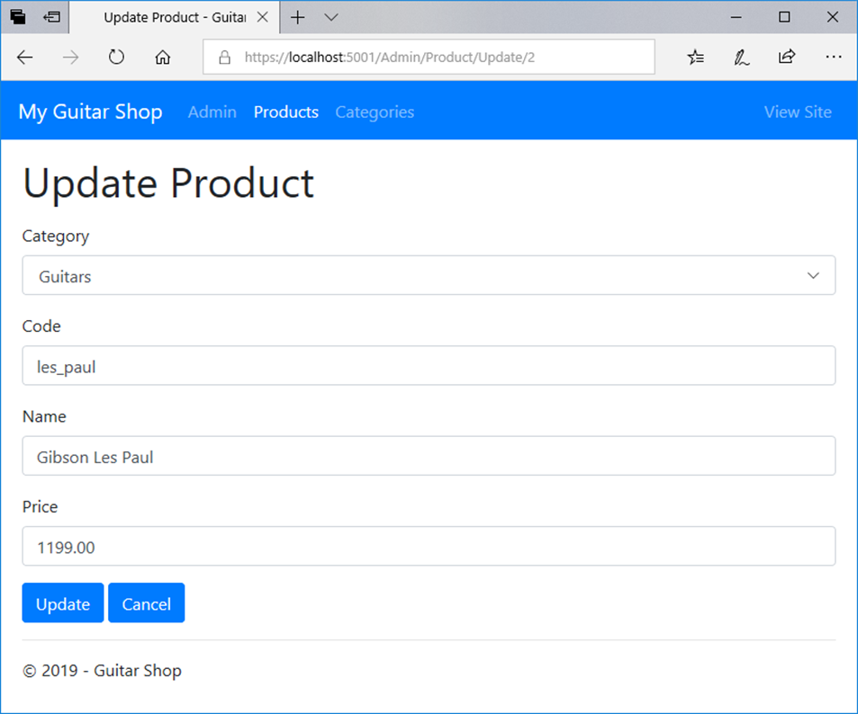
The Update Product page

Slide 79
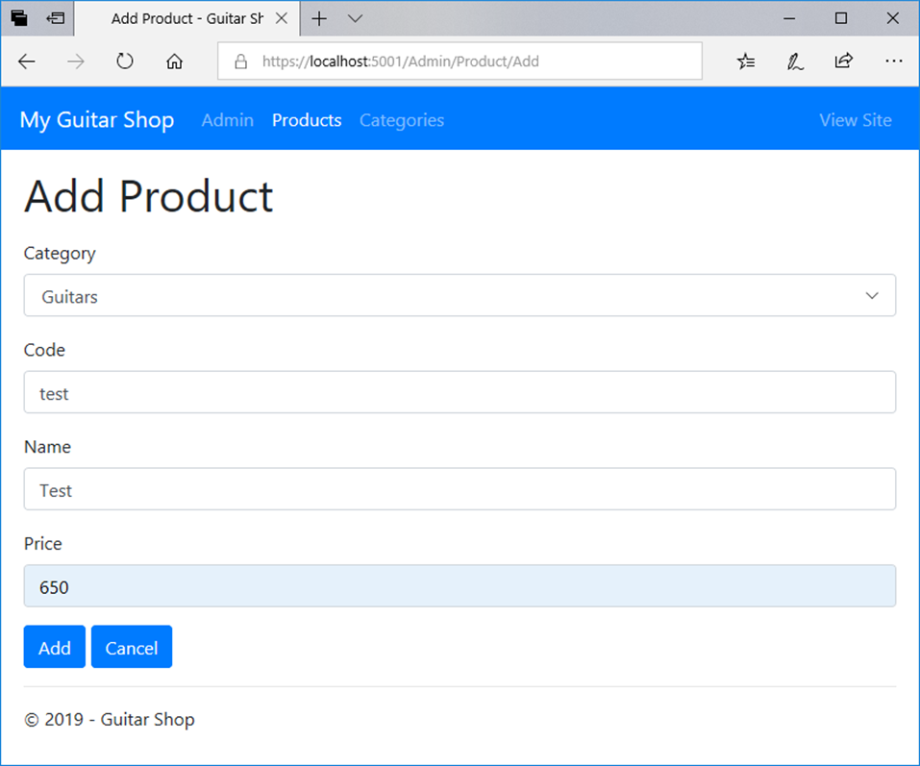
The Add Product page

Slide 80
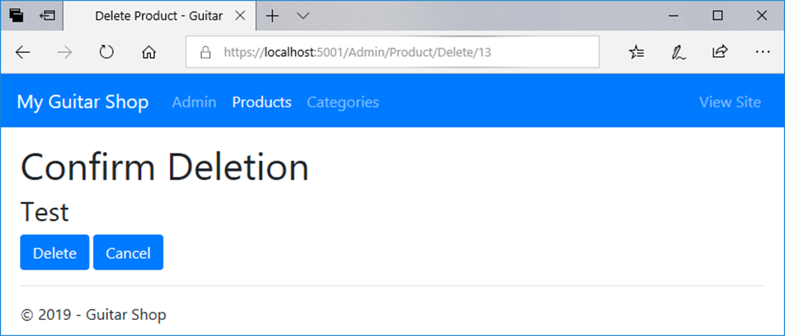
The Delete Product page

